Slide 1
Technologies

Slide 2
Parallel processing vs normal processing

Slide 3
Time needed for simple tasks

Slide 4
Stress testing

Slide 5
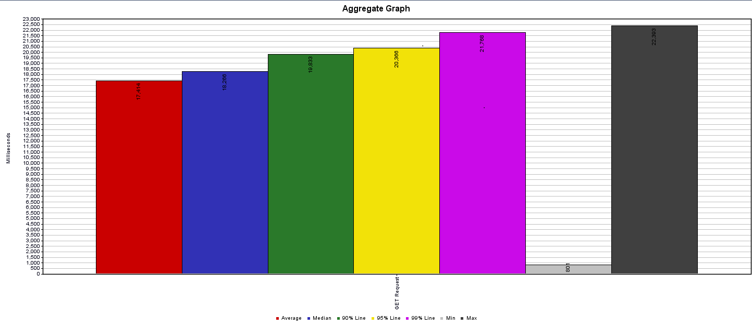
GET Request

Slide 6
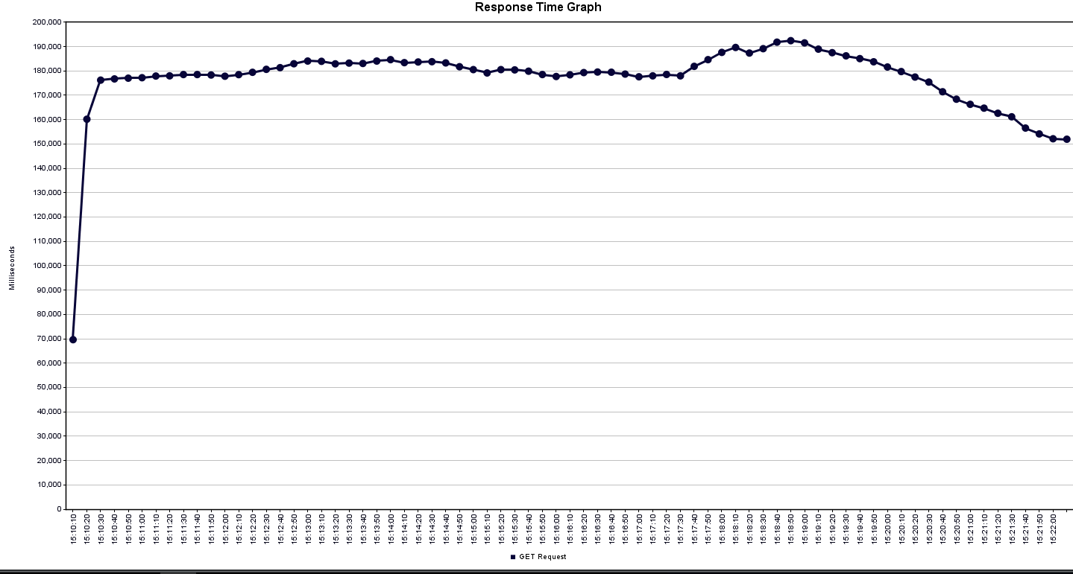
Response time graph

Slide 7
Common sorting algorithms

Slide 8
Time comparison

Slide 9
String searching algorithms

Slide 10
Time comparison

Slide 11
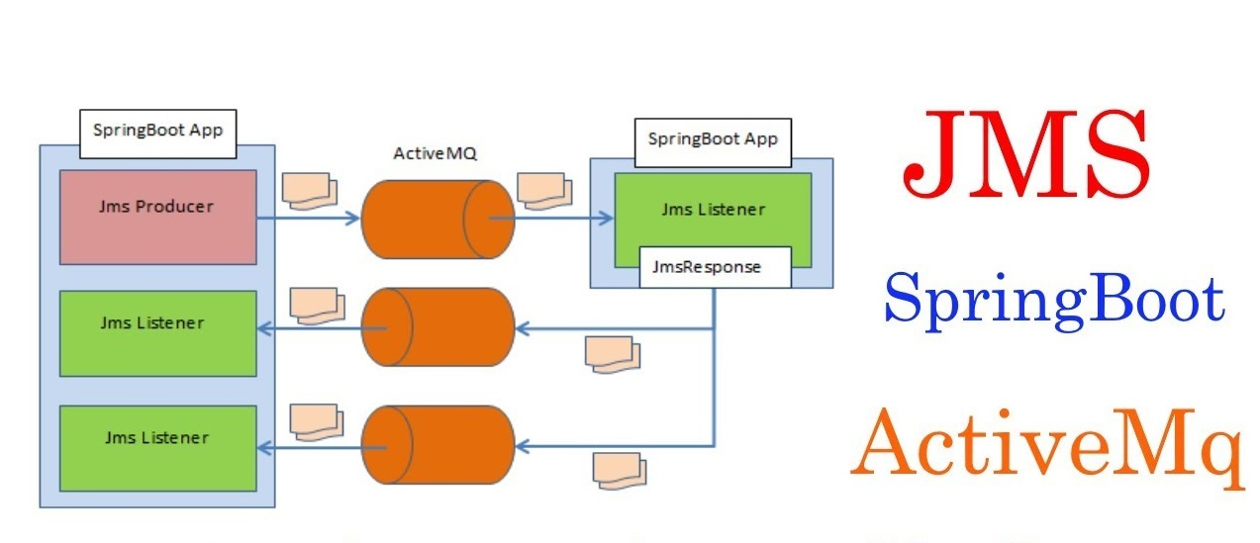
ActiveMQ

Slide 12
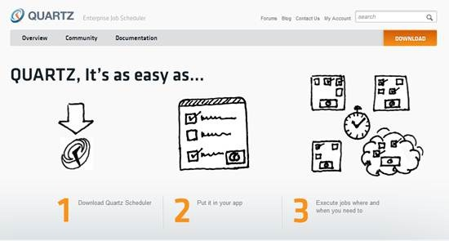
Quartz

Slide 13
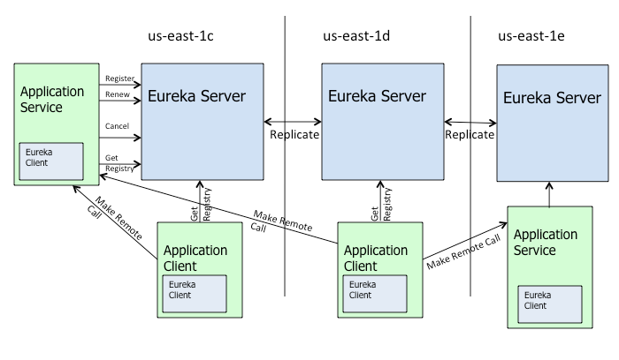
Eureka

Slide 14

Questions time

Slide 15
Bibliography
http://www.quartz-scheduler.org/documentation/
https://docs.spring.io/spring-boot/docs/current/reference/html/boot-features-messaging.html
https://www.geeksforgeeks.org/sorting-algorithms/
https://study.com/academy/lesson/string-searching-algorithms-methods-types.html
https://jmeter.apache.org/usermanual/index.html
https://docs.spring.io/spring-batch/3.0.x/reference/html/scalability.html

